Slide 1
Unraveling Political Discourse on Social Media
437 Group
Samuel Zhang,Jean Dong Cho,
Ryan Luder,Charles Allbritton
Notes:
"Hello everyone, today I'm excited to present our project on unraveling political discourse on social media. I'm Samuel Zhang and this project was a collaborative effort involving Jean Dong Cho,Ryan Luder, and Charles Allbritton"

Slide 2
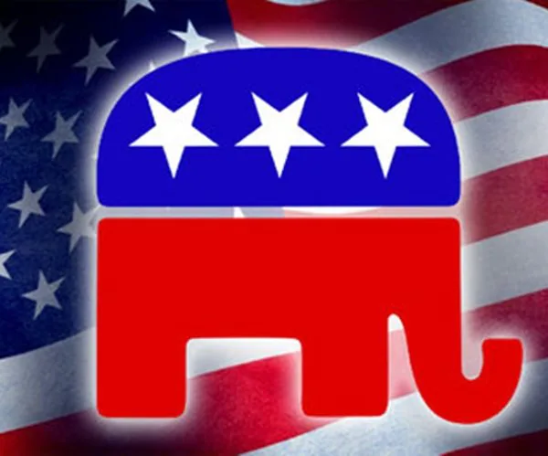
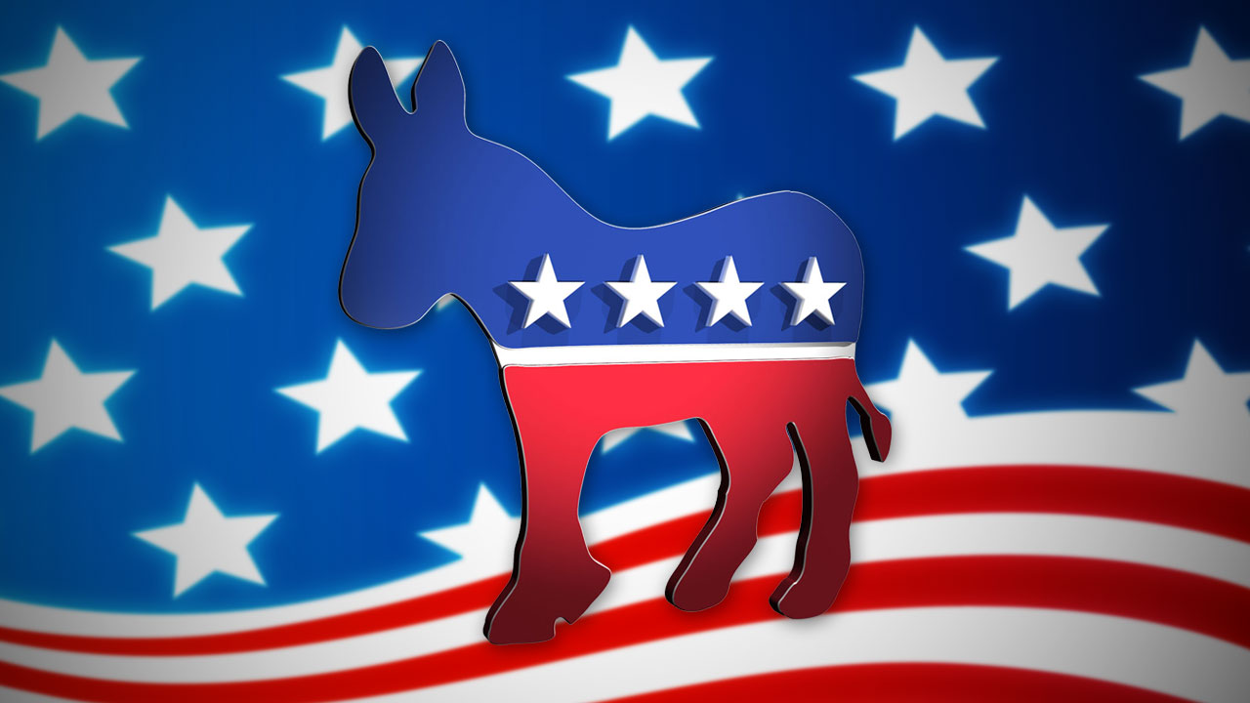
Objectives and Motivation
Notes:
"Our project aims to explore language differences between supporters of different political parties. We're motivated by the desire to foster a deeper understanding of viewpoints held by Republicans and Democrats."

Slide 3
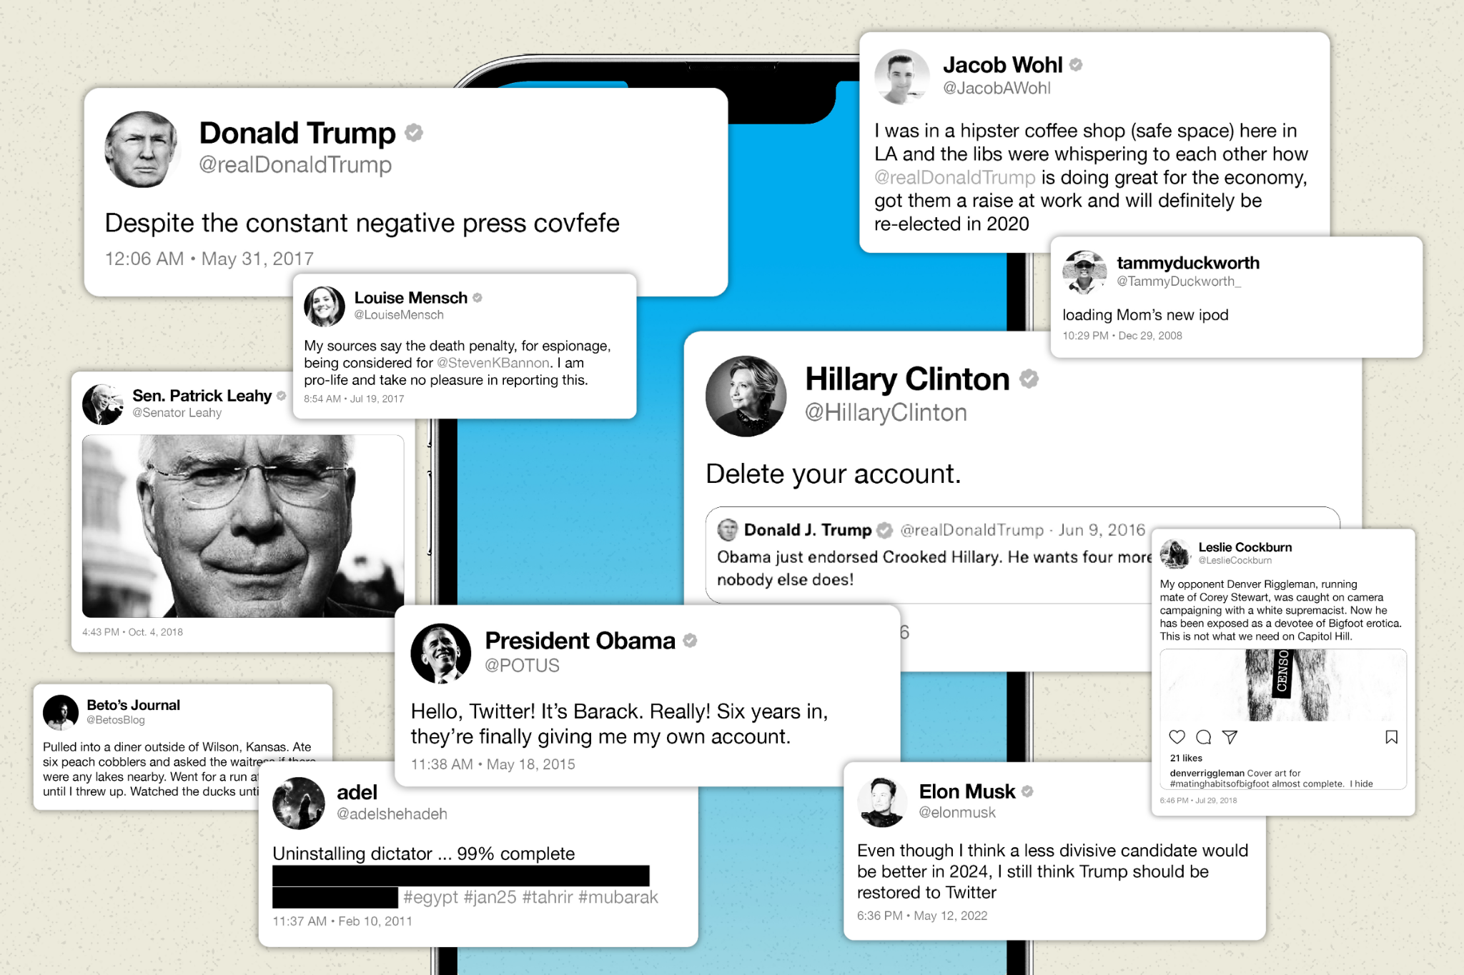
Delving into the Questions
Notes:
"As we delve into our project, we're aiming to answer critical questions about language differences, accurate party classification, and gaining insights into political discourse on platforms like Twitter."

Slide 4
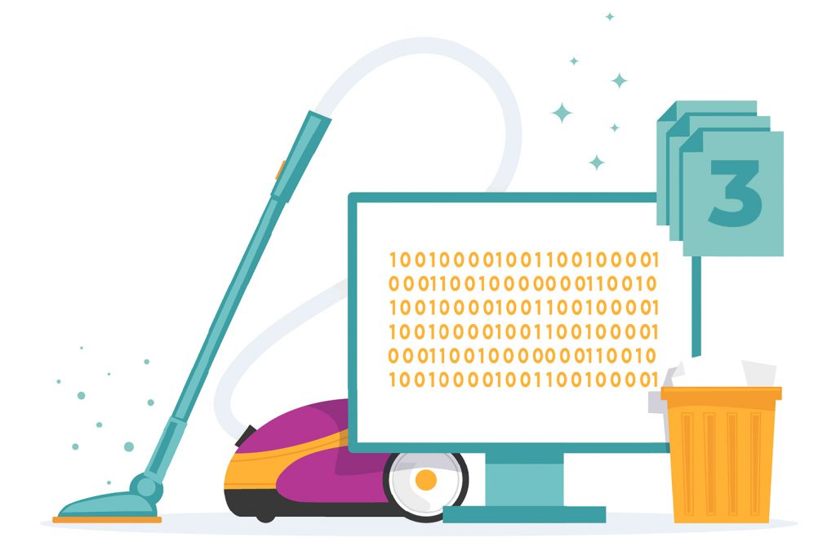
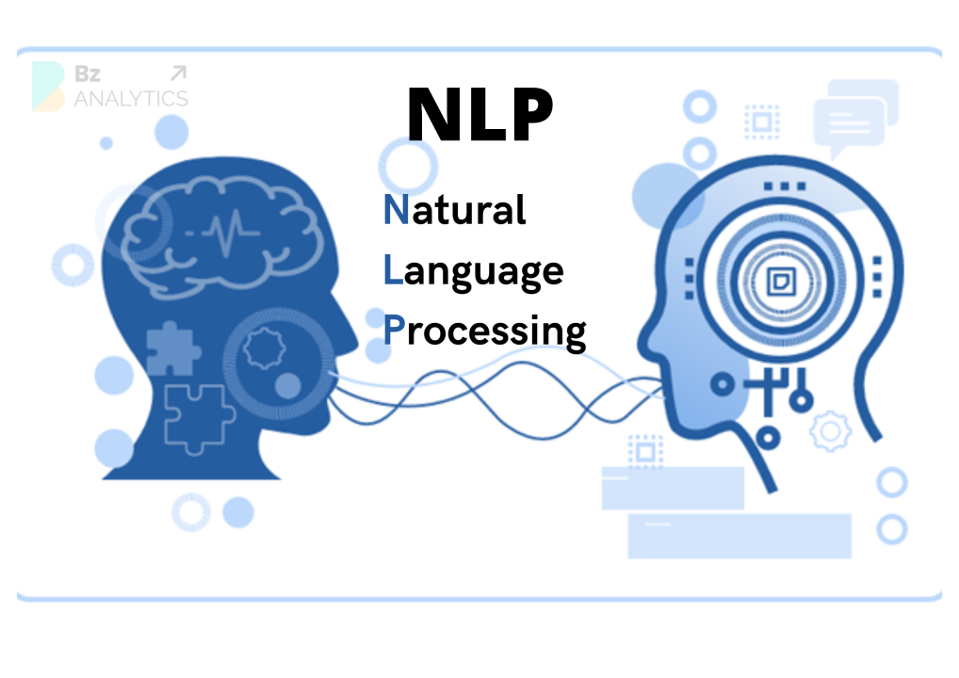
Our Approach
Notes:
"Let's talk about our approach. We sourced our data from Kaggle, emphasized ethical considerations during data cleansing, and applied Natural Language Processing techniques to extract meaningful patterns from tweets."

Slide 5
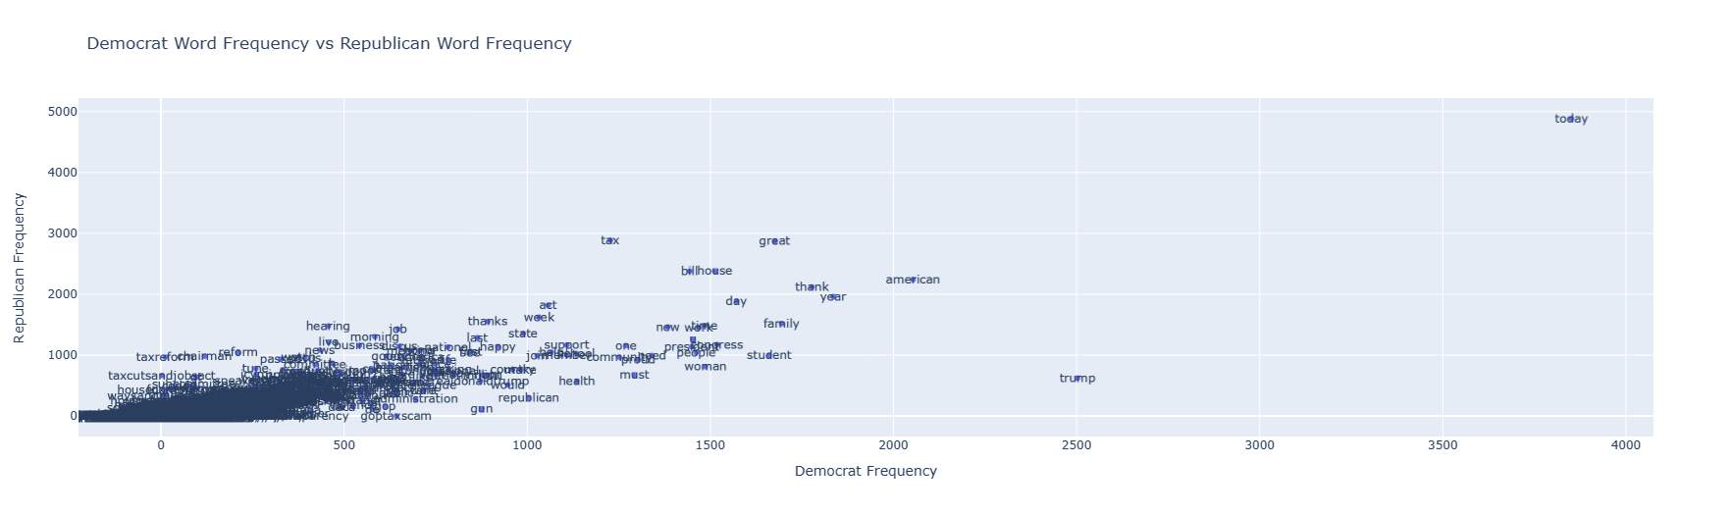
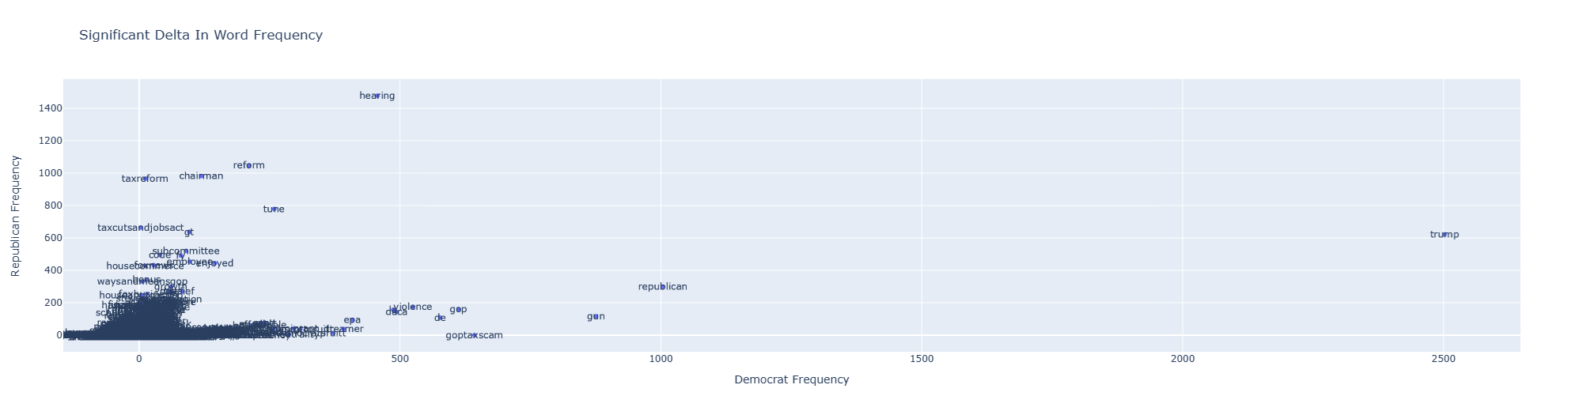
Communicating Through Visuals
Notes:
"Visualizations play a crucial role in communicating our findings. We utilized scatter plots using Matplotlib and Plotly for effective communication. By using this scatter plots, we can see which words are frequently used for each party for example we can observe that the words used more by republicans are economical, as opposed to democrats, who are more socially driven. we can also notice that the context of the language used by republicans were more from inside, while democrats focused on issues that were more outside.(republicans more political, democrats more social)"

Slide 6
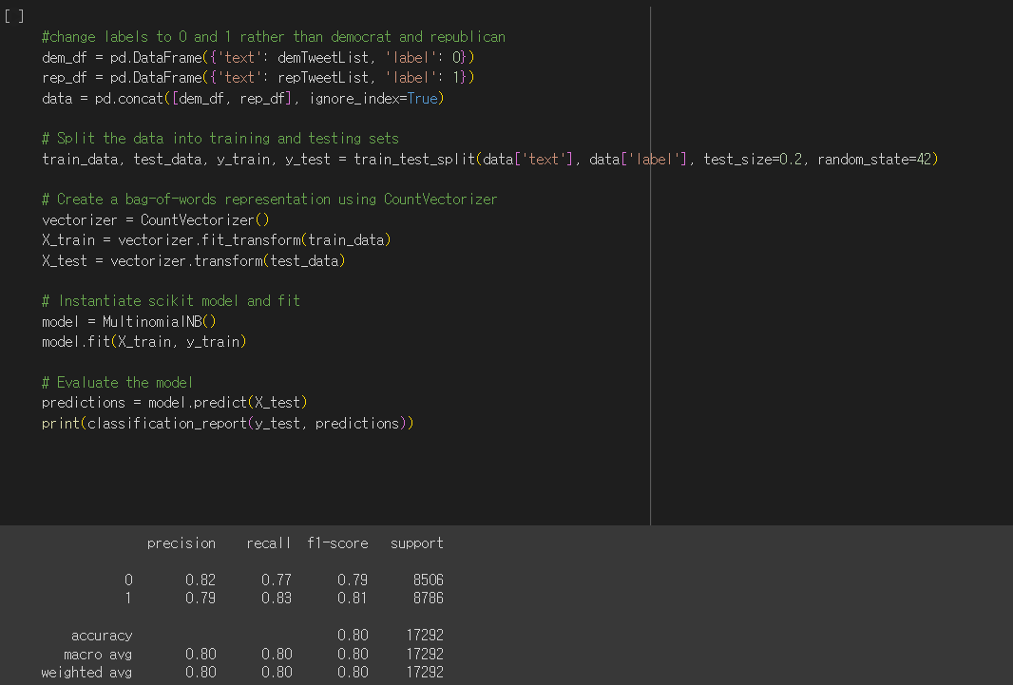
Unraveling the Model
Notes:
"Now, let's unravel the models. We initially used Multinomial Naive Bayes for party classification."

Slide 7
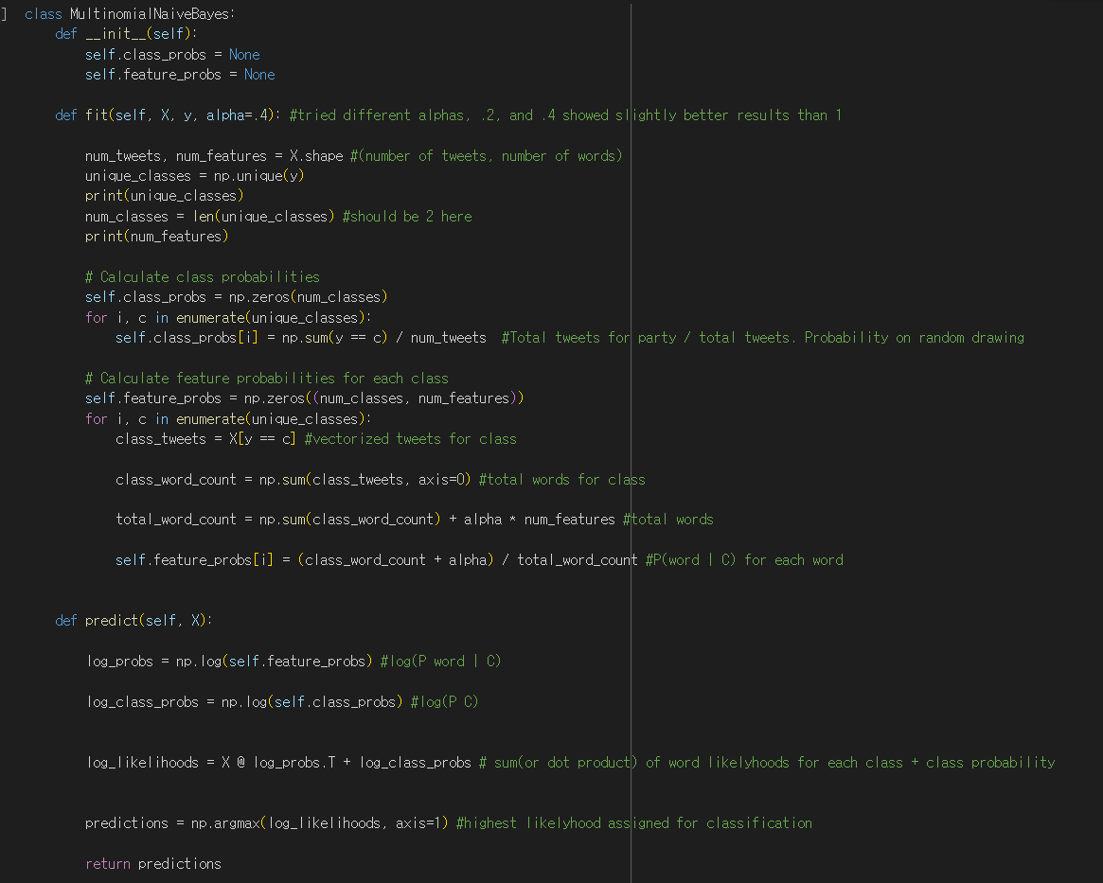
Our Own Model
Notes:
"We didn't stop there. We went a step further and implemented our own simple interpretation of a Multinomial Naive Bayes classifier,an implementation to show that both models give similar results, experimenting with different alpha values to give our model a very small edge in accuracy. Our implementation initially showed very similar accuracy results, showing that our implementation is very close to the library’s model. The advantage to starting our own however, is that we can tailor it to better fit the subject of our training in the future."

Slide 8
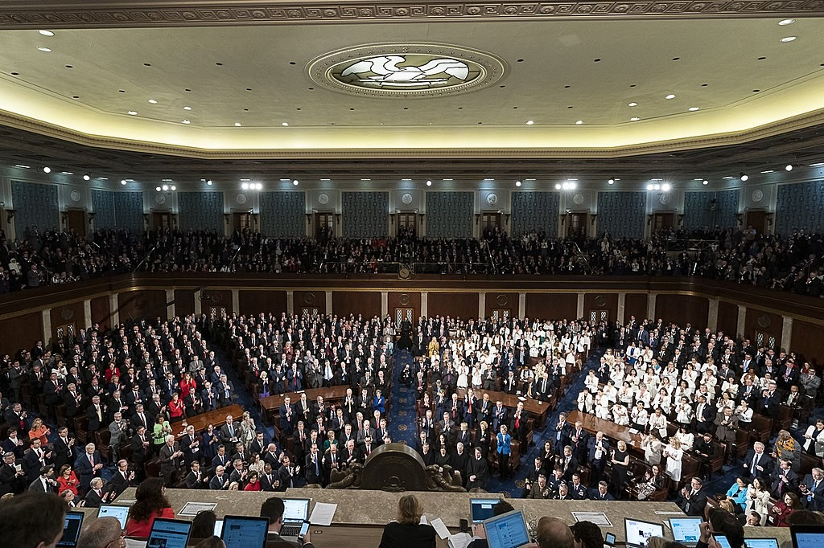
Empirical Insights
Notes:
"Our empirical phase provided fascinating insights into the linguistic disparities between Republican and Democratic supporters. Our own Multinomial NB model, a probability based classifier demonstrated promising results in accurately classifying tweets."

Slide 9
Wrapping Up and Looking Forward
Model fine-tuning
Exploring deployment options
Continuous monitoring for real-time adaptation
Notes:
"As we wrap up, our project has contributed valuable insights into political discourse analysis. Looking forward, we're considering model fine-tuning, exploring deployment options, and continuous monitoring for real-time adaptation."

Slide 10
Demo
https://colab.research.google.com/drive/1abEtYl3XvuHE4EzRHtxWZnXqZd4gQQdb?usp=sharing
Notes:
“And now here is the Demo for our code”

